Slide 1

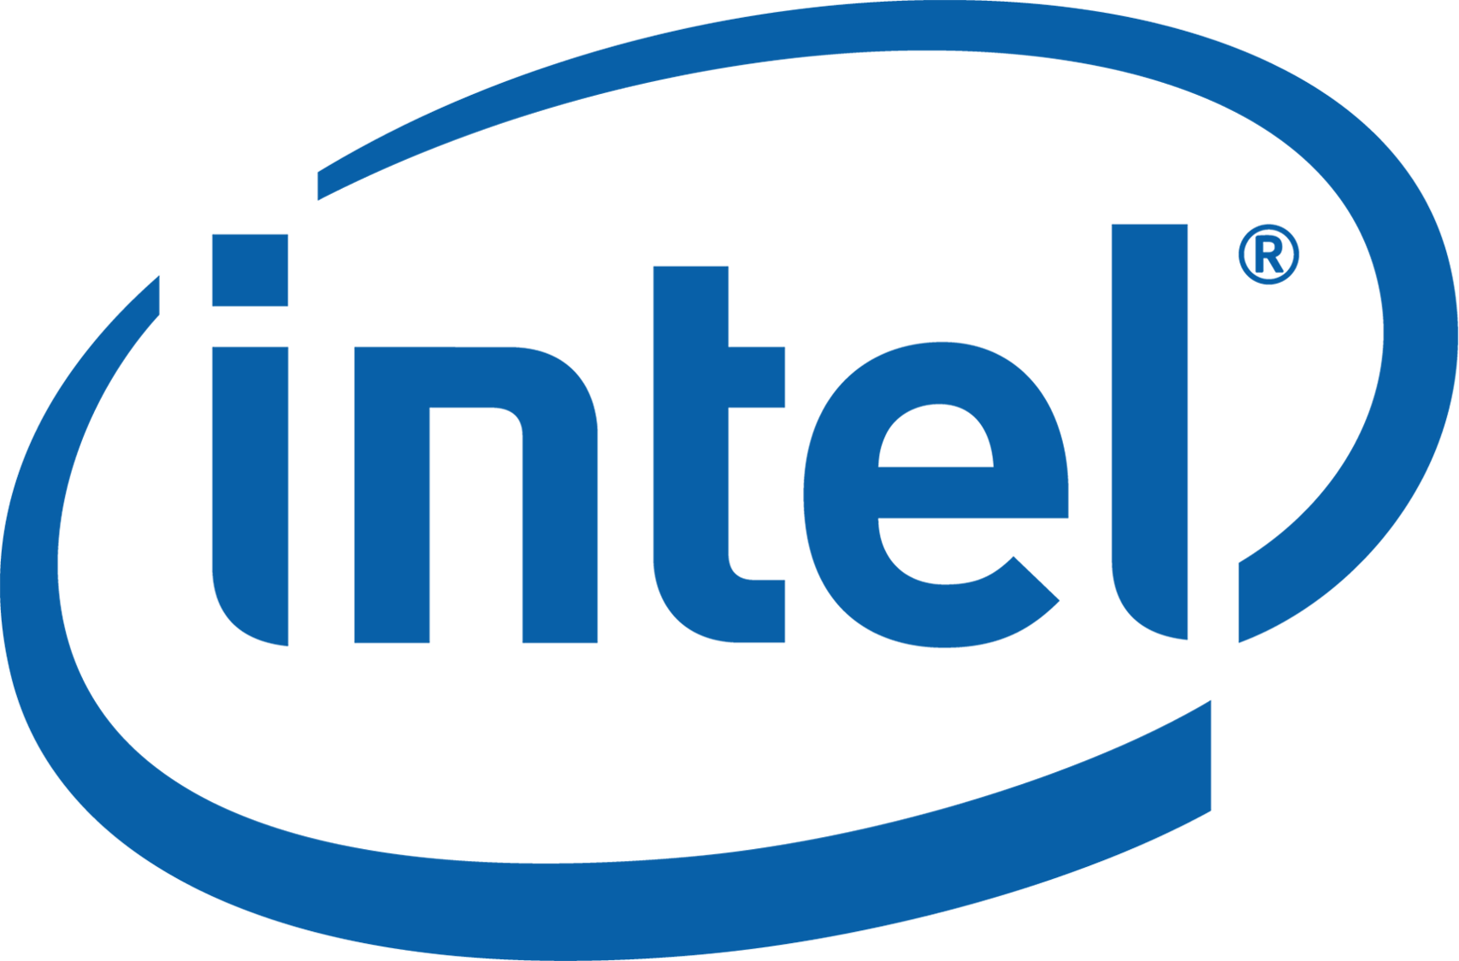

Don’t Forget the I/O When Allocating Your LLC
Yifan Yuan¹, Mohammad Alian², Yipeng Wang³, Ren Wang³,
Ilia Kurakin³, Charlie Tai³, Nam Sung Kim¹
¹UIUC, ²University of Kansas, ³Intel
Notes:
Hi everyone! I’m Yifan Yuan, a PhD student of UIUC. Today I’m going to introduce our work don’t forget the I/O when allocating your LLC. This is a joint work with Intel and university of Kansas.

Slide 2
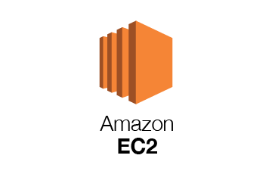
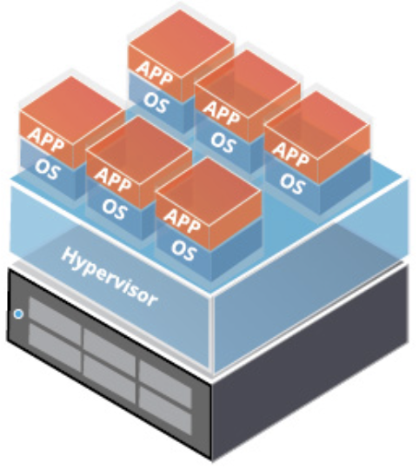

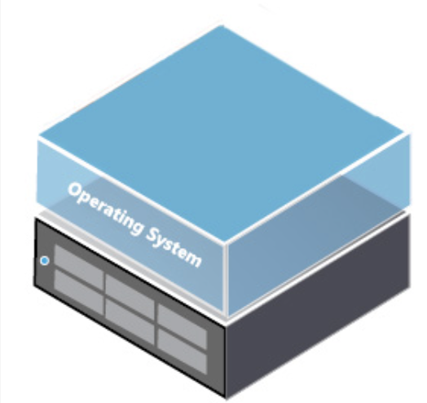
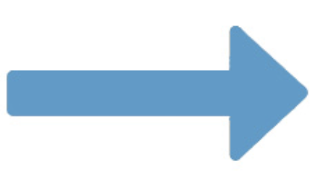
Resource-sharing is Everywhere in the Cloud
Resource-sharing offers higher utilization and efficiency for virtualized cloud
Notes:
Nowadays, cloud data centers have been virtualized.
With the advanced virtualization techniques, such as Amazon EC2, docker container, and Linux KVM, multiple tenants or applications can consolidate on the same server, sharing hardware resources.
This makes the cloud data center more efficient, more scalable, and more flexible.

Slide 3



Resource-sharing Leads to Interference
We need to carefully allocate and isolate hardware resources across tenants
In this work, we focus on last-level cache (LLC)
Cartoon credit: DC-Store: Eliminating Noisy Neighbor Containers using Deterministic I/O Performance and Resource Isolation, FAST’20
Notes:
Unfortunately, the benefit of resource-sharing is not free.
Tenants may compete with each other for the shared hardware, including cores, cache, memory, and devices.
This can lead to severe performance interference.
Hence, we need to carefully allocate and isolate hardware resources across tenants.
In this work, we focus on the last-level cache (LLC).

Slide 4
LLC Management on Modern Server CPU
Intel resource director technology (RDT) enables LLC management on commodity CPU
We have mechanisms from the core point of view.
But how about I/O?
Notes:
LLC allocation is not a new problem and has been studied for many years.
However, such functionalities didn’t appear in the real-world commodity hardware until recently.
In 2016, Intel proposed and implemented resource director technology (RDT) on most of its Xeon server CPU lineup.
For example, cache monitoring technology (CMT) can let the user know the LLC capacity consumption of a CPU core/application.
Cache allocation technology (CAT) enables per core/process LLC allocation in cache-way granularity.
Now, we have the weapon to solve LLC contention between CPU cores.
And the question is, how about I/O?

Slide 5
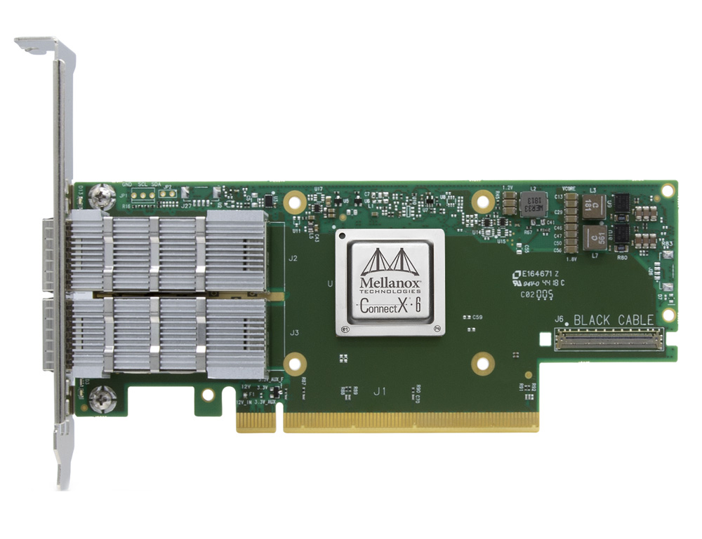

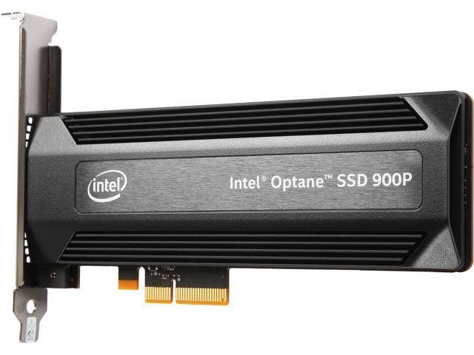
Why I/O Matters?
100Gb NIC
Optane SSD
Intel data-direct I/O (DDIO) enables LLC directly to communicate with I/O devices, introducing new challenges
Notes:
Why I/O matters here?
This is because of an Intel architectural innovation call “data-direct I/O” or DDIO.
Conventionally, when transferring data from a device to the host, the DMA destination is the main memory.
However, with the development of modern I/O devices, such as 100Gb network card and high-speed SSD, memory can become the bottleneck in this data path.
Hence, DDIO enables the device to inject data to part of the LLC, bypassing the relatively slow main memory.
In other words, now with DDIO, the LLC and device can talk directly.
This also introduces new challenges for LLC management.

Slide 6
The Leaky DMA Problem
Identified by ResQ (NSDI’18), Shenango (NSDI’19)
Large buffer (packet size), small LLC portion
Rx ring buffer
in software
Notes:
Here we discuss two DDIO-related problems.
The first is the leaky DMA problem, which has been identified recently by other works.
In general, we use in-memory ring buffer as the data structure to let the CPU and high-speed device interact with each other.
Also, as I just mentioned, DDIO will write data to part of the LLC.
This LLC portion could be small to only accommodate part of the ring buffer, especially when the packet size is large.
As a result, if the core cannot process the data in time, the data can be evicted to the main memory by the new data, causing unnecessary memory bandwidth waste.

Slide 7
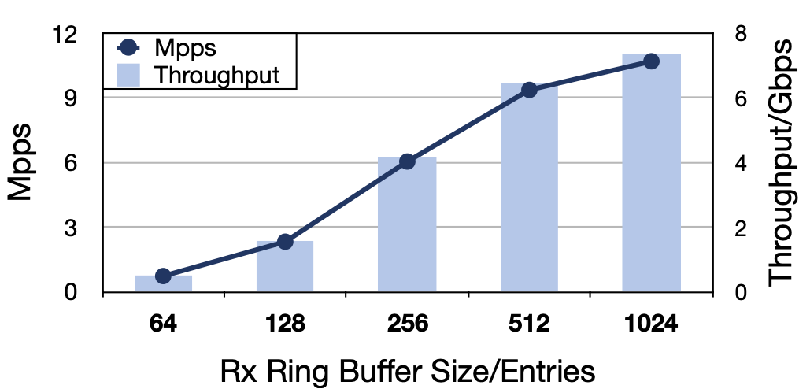
The Leaky DMA Problem
Use small buffer (ResQ)? NO!
There can be many buffers
small buffer size will decrease the throughput
RFC-2544 test result (64B pkt) with 40GbE
We need to adaptively allocate more/less LLC ways for DDIO
Notes:
So how to solve this problem?
The ResQ work proposed a naive solution by simply using a small ring buffer.
However, we argue that this solution does not work all the time.
First, there can be many buffers on a single virtualized server for multiple tenants, and the total buffer size can add up to a large value.
Second, small buffer size can hurt the performance.
We run a simple RFC-2544 lossless test and sweep the buffer size to illustrate this point.
We find that by cutting the buffer size from default 1k entries to 512, there will be a 13% throughput drop, and if we further shrink the size, the throughput will drop much more significantly.
This is because with smaller buffer size, the NIC is more likely to drop packets since there is no available buffer entry.
Hence, this motivates us to adaptively allocate more/fewer LLC ways for DDIO.

Slide 8
The Latent Contender Problem
Regular CAT:
Unaware of I/O
DDIO
Performance degradation of X-Mem microbenchmark
We need to intelligently choose core(s) to share LLC ways with DDIO
Notes:
We also identify a second DDIO-related problem – the latent contender problem.
Again, we have DDIO that writes data to part of the LLC.
On the other hand, we also do LLC allocation on the core side with regular CAT.
However, the regular CAT is unaware of DDIO.
The consequence is, the CAT is likely to allocate DDIO’s LLC ways for the cores.
This creates an illusion of 100% isolation but does incur performance interference, even though the application does not involve any I/O operation.
We use X-Mem, a microbenchmark for applications memory characteristics to show that.
As shown in this figure, when X-Mem’s LLC ways overlap with DDIO’s, both the latency and throughput performance will drop by as high as 30%.
Hence, we need DDIO-awareness and should intelligently choose core(s) to share LLC ways with DDIO.

Slide 9






IAT: the First I/O-ware LLC Management Mechanism
System-wide daemon on commodity platform
Monitor core, LLC, and DDIO via CPU counters
Dynamically adjust DDIO’s LLC ways to mitigate contention
Notes:
To tackle these two problems, we propose IAT, the first I/O-aware LLC management mechanism.
IAT is a software daemon that requires no specialized hardware to run on.
It monitors the status of CPU core, LLC, and DDIO by periodically reading CPU’s hardware performance counters.
Based on this information, it dynamically adjusts DDIO’s LLC ways to mitigate contention.
Now, let me talk about IAT’s design in detail.

Slide 10
IAT Execution Flow
Read CPU counters
Initialization
Make decision
Take
action
Notes:
We first introduce IAT’s execution flow.
There are 6 major steps in IAT – get tenant info, LLC alloc, poll perf data, state transition, LLC re-alloc, and sleep.
Upon initialization, IAT first learns the tenant information from the scheduler and allocates LLC ways for each of them.
Then, it periodically polls the performance data from hardware counters.
These values will be compared against those collected in the previous iteration.
If the difference exceeds a certain threshold, we move to the state transition step.
In state transition step, we determine the system status based on the collected performance data, and take corresponding actions in the LLC re-alloc step.
IAT then will sleep for a while to let the LLC allocation take effect. The specific interval length is a configurable variable.

Slide 11
Performance Metrics
IPC: application’s performance
LLC ref/miss: application’s cache/memory characteristics
DDIO hit/miss: DDIO status
Notes:
Regarding the performance metrics, we have three.
The first two, IPC and LLC ref/miss is quite common – they basically depict the running status of the applications, as well as the memory behavior.
The last one, DDIO hit/miss, means whether the corresponding cache line is already in the LLC. Here, hit means we only need to update the cache line, while miss means we need to allocate a new slot in the LLC for the incoming data.
DDIO hit/miss reflects the intensity of the I/O traffic and its pressure on the LLC.

Slide 12
State Transition
More DDIO hit and miss mean intensive I/O traffic
DDIO way count reaches limit
Less DDIO hit means core is pressing LLC
Notes:
The core of IAT is a finite state machine, as shown in this diagram, it has 5 states.
At initialization, IAT always starts from the “low keep” state.
When it detects more DDIO hit and miss, it knows that I/O traffic is more intensive, and thus move to the “I/O demand” state, and will add one more LLC way to DDIO per iteration, until the ways reach an upper bound.
On the other hand, if it sees more DDIO miss and fewer hit, it knows the core is pressing the LLC.
As a result, it transits to the ”core demand” state, and will add more LLC ways for the corresponding cores.

Slide 13
LLC Re-allocation Example (1)
Notes:
To illustrate how IAT reallocates LLC, we use two examples.
In the first example, we have one performance-critical tenant and two best-effort tenants.
They are connected to a software virtual switch via virtIO, and the virtual switch directly communicates with the physical NIC.
Traffic from another traffic generator machine comes from the NIC to the virtual switch and is dispatched to tenants.
In the beginning, we have the following LLC allocation, and the flow count in the traffic is small.
Later at t1, we increase the flow count in the incoming traffic.
This leads to more space required by the virtual switch since it needs to store more flows in its forwarding table.
Hence, IAT enters the “core demand” state and allocates more ways to the virtual switch’s cores.
At t2, we reduce the flow count, and since there is no need to maintain a big forwarding table, IAT enters the “reclaim” state and reduces the virtual switch’s LLC portion.

Slide 14
LLC Re-allocation Example (2)
Notes:
In the second example, we still have the three tenants.
However, this time they directly communicate with the physical NIC by hardware virtualization technique.
Again, traffic comes from outside and is dispatched to each tenant.
In the beginning, we have this LLC allocation, and the traffic is not intensive.
At t1, we increase the network traffic throughput, and IAT detects this by more DDIO hit and miss.
Consequently, IAT assigns more LLC to DDIO to make room for the intensive in-bound traffic.
At t2, the best-effort tenant-2 has a working phase change, requiring larger working set.
This leads to contention between the core and DDIO for the LLC space.
IAT then chooses best-effort tenant-1 with a small memory footprint to share LLC ways with DDIO to mitigate the contention.
Of course, we also have the similar “reclaim” mechanism, as shown at t3.

Slide 15
More in the Paper
State transition conditions
LLC re-allocation policies
Real application evaluations
….
Notes:
There are also other aspects of our design. Please check our paper for more details.

Slide 16
Methodology
Implementation: user-space daemon in Ubuntu 18
Testbed: Intel server with four Xeon 6140@2.3GHz CPUs and two X710 40GbE NICs
Microbenchmarks: DPDK-based test-pmd, X-Mem, OVS
Real applications: OVS, SPEC2006, RocksDB (memtable), Redis, fast-click
Everything is running in docker container
Notes:
We have implemented and evaluated IAT on real hardware as a user-space daemon on Ubuntu 18.
The server is equipped with four Xeon 6140 CPUs and two 40Gb Ethernet NICs.
We use both microbenchmarks and real applications to test IAT’s effect.
Due to the time limit, I will only discuss the microbenchmark results in this talk, including DPDK test-pmd, X-Mem, and OVS.
Also, to reflect the virtualized cloud environment, everything is running in the docker container.

Slide 17
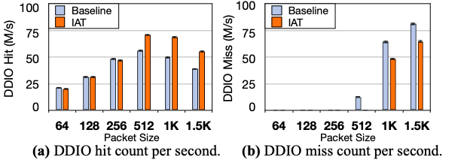
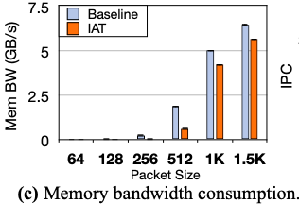
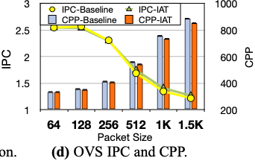
Experiment – Solving the Leaky DMA Problem
We simply forward line-rate traffic (varying packet size) across NICs
Notes:
First, we show that IAT can help mitigate the Leaky DMA problem.
In this experiment, we have two containers running DPDK-pmd, which simply forward packets to the other physical NIC though OVS.
We compare multiple results with and without IAT.

Slide 18
Experiment – Solving the Leaky DMA Problem
We simply forward line-rate traffic (varying packet size) across NICs
Notes:
The first and most straightforward metric is DDIO hit/miss count per second.
As shown in these two figures, when the packet size is small, IAT doesn’t make any difference since the default LLC portion for DDIO is enough.
However, when the packet size is large, IAT is able to reduce DDIO miss by around 30%.

Slide 19
Experiment – Solving the Leaky DMA Problem
We simply forward line-rate traffic (varying packet size) across NICs
Notes:
This leads to the reduction of memory bandwidth utilization,

Slide 20
Experiment – Solving the Leaky DMA Problem
We simply forward line-rate traffic (varying packet size) across NICs
Notes:
and finally, IPC and cycle per packet improvement in the OVS execution.

Slide 21
Experiment – Solving the Leaky DMA Problem
We simply forward line-rate traffic (varying packet size) across NICs
IAT + medium-size buffer will provide even better performance
Notes:
Note that such difference will be much more significant with the 100Gb or even 400Gb network in the near future.
Since IAT cannot eliminate the DDIO miss, we argue that. IAT plus a. medium size buffer can provide even better performance.

Slide 22
Experiment – Solving the Latent Contender Problem
We deliberately change X-Mem working set size (at 5s) and DDIO ways (at 15s) to create the problem during runtime
Compared to I/O-unaware LLC allocation, IAT achieves ~40% lower latency and ~50% higher throughput for PC tenant
Notes:
We then verify whether IAT can solve the latent contender problem.
Specifically, we deliberately change X-Mem’s working set size and DDIO ways to create the problem during the runtime.
We have 4 tenant containers, one running test-pmd directly on the NIC, the others are X-mem with different priorities.
We demonstrate the LLC miss count on the performance-critical container 4.
In the beginning, the miss count is low because the container’s LLC portion is completely isolated.
At the 5th second, since the working set of container 4 is changed to 10MB, more LLC miss happen on it.
IAT mitigates this by shuffling the LLC ways of container 3 and 4 since container 3 still has a small working set.
At the 15th second, we increase DDIO’s ways to four, creating anther contention and high LLC mis count.
Again, IAT shuffles the LLC allocation to make sure the isolation of the performance-critical tenant.
After one second’s adjustment, the LLC miss of the container returns to a low level.
We also measure the X-mem results in container 4 and find that IAT can let X-mem achieve ~40% lower latency and ~50% higher throughput compared to I/O-unaware LLC management mechanisms.

Slide 23
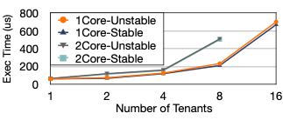
Experiment – IAT Overhead
We measure IAT’s execution time when monitoring different numbers of tenants
One/two cores per tenant
Stable: no need to re-allocate LLC
Unstable: need to take action
IAT’s overhead is negligible
Notes:
Finally, we evaluate IAT’s runtime overhead on a dedicated core.
Specifically, we measure its execution time when monitoring different numbers of tenants.
Each tenant can occupy one or two cores.
We classify IAT’s behavior into ”stable” and “unstable”.
Stable means all time is spent on monitoring, while ”unstable” also includes the time of decision making and LLC reallocation.
From the result, we can find that the execution time increases roughly linearly with the number of cores, and the monitoring part is the major overhead.
Having that said, the total execution time of a single iteration doesn’t exceed 800us, which is negligible considering its sleep interval.

Slide 24
Conclusion
DDIO introduces new challenges to LLC management, and its default configuration may not be optimal all the time
Tackling the leaky DMA problem and the latent contender problem, we propose IAT, the first I/O-aware LLC management mechanism
Evaluation with microbenchmarks and real applications shows IAT can effectively mitigate the performance interference caused by DDIO, with low runtime overhead
Open-source library: https://github.com/FAST-UIUC/iat-pqos
Notes:
To recap, with the advent of DDIO, high-performance I/O devices have become a critical factor in server’s LLC management, bringing new challenges.
In this work, aiming to the leaky DMA problem and the latent contender problem, we design IAT mechanism that treats the I/O as the first-class citizen in LLC management.
According to the real-hardware evaluation, we find by dynamically tuning DDIO’s configuration, IAT is able to mitigate the interference caused by DDIO, offering better performance and isolation.
We Also open source our enhanced PQOS library with DDIO functionalities to facilitate the future research in the community.

Slide 25

Contact the author: yifany3@Illinois.edu, https://yifanyuan3.github.io
Notes:
Thanks for your listening. Please feel free to contact me for any questions.

Slide 26
Future DDIO Consideration
Remote DDIO: support cross-socket traffic
Fine-grained DDIO in hardware: steer every single PCIe packet to LLC or memory
Device-aware DDIO: distinguish between different I/O devices; allocate LLC ways for them separately
Notes:
Last, we discuss our thoughts on how DDIO should evolve in the near future.
First, the current DDIO is restricted on the local socket that the I/O device is attached to. We expect the concept to be extended to remote socket in a NUMA system.
Second, the current IAT mechanism is coarse-grained both spatially and temporally. We hope that IAT-like mechanism can be implemented in hardware to steer each PCIe packet to different places.
Last but not least, the current DDIO cannot distinguish between traffic from multiple devices, leading to inter-device contention. We expect that DDIO can be device-aware so that the user can allocate LLC ways for each device.

